Slide 1
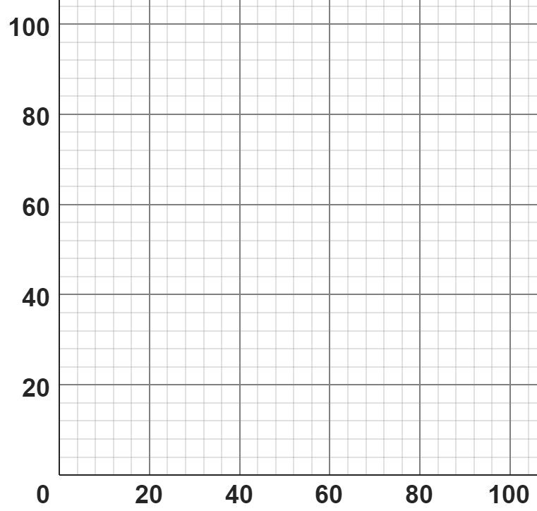
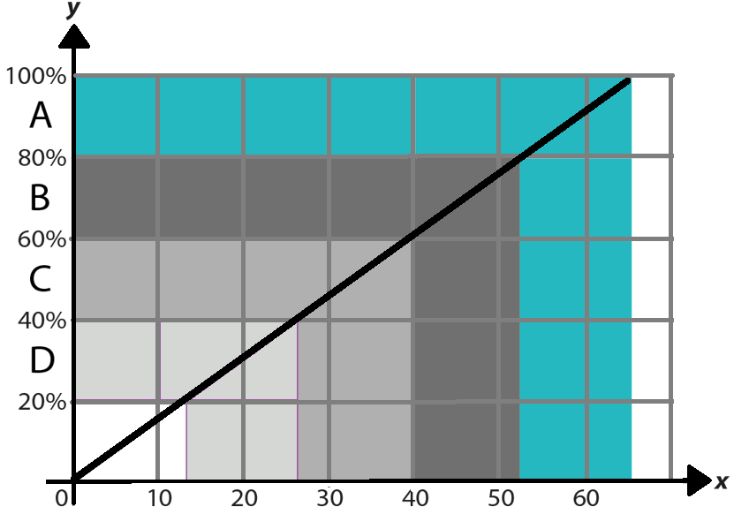
Multiplicative relationships presented graphically
Task A: Percentages of amounts graphically
1) Match the double number line with the corresponding graph.
%
%
%
%
£
£
£
0%
80%
0%
100%
0%
80%
0%
£0
£100
£0
£80
£0
£50
£0
2) A class of students took a test. The grades available were A, B, C or D.
The graph helps the teacher convert a score out of 65 to a grade.
Jun scored 35 marks on his assessment.
a) What grade did Jun get?
b) Estimate his percentage score.
c) Estimate the minimum mark you need to get a grade. What calculation could you carry out to be more accurate?
35 marks is a grade C.
Jun scored 54% (an estimate between 50% and 60% is reasonable).
Mark
13 is the minimum mark needed for a grade. The calculation is 65 × 0.2 (or equivalent).

Slide 2
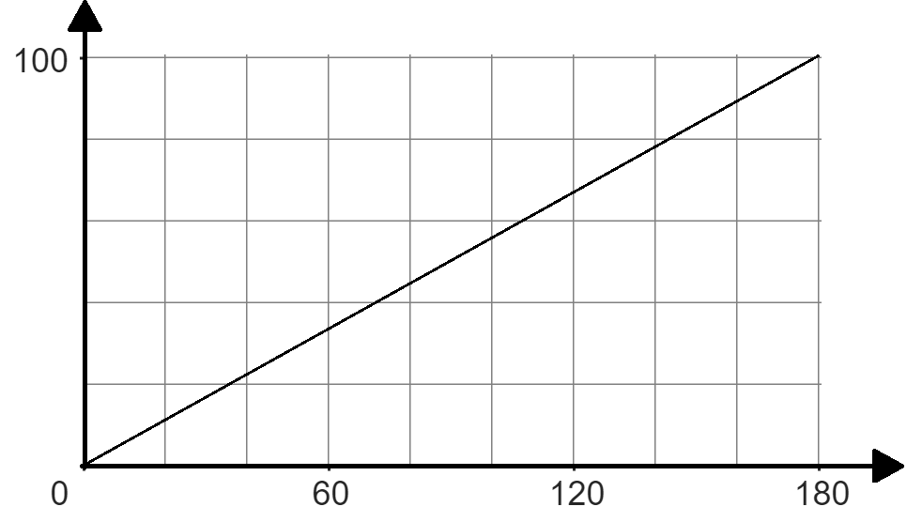
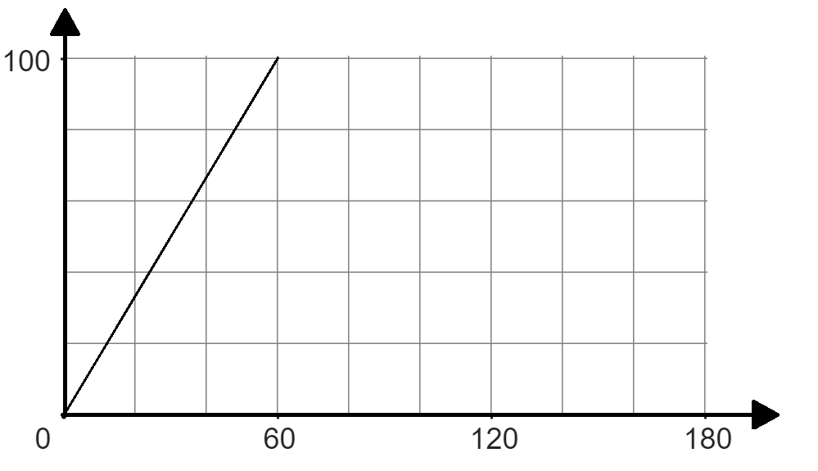
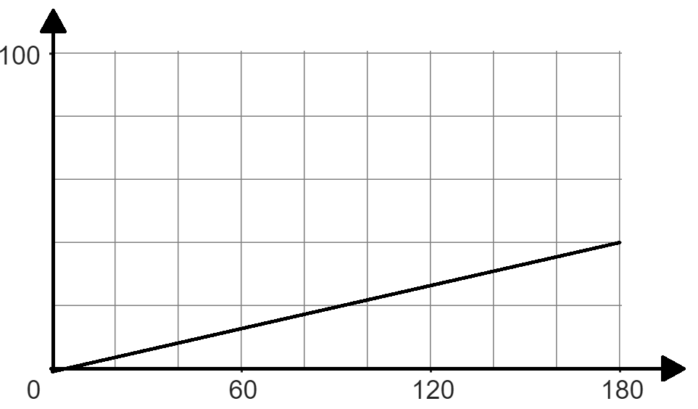
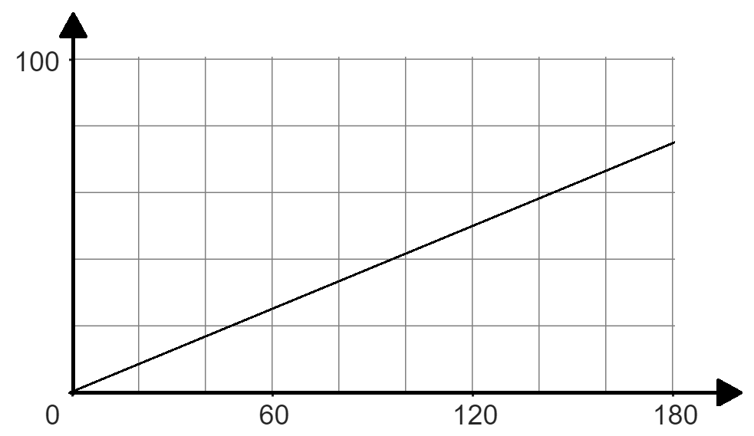
Multiplicative relationships presented graphically
3a) Fill in the missing information given the graph and double number line.
%
%
£
£
£
40
100
20
100
%
%
£
60
£
72
180
12
3b) Fill in the missing information given the graph and double number line.
%
%
£
£
.
40
100
33.3
100%
%
%
180
450
£
240
£
80

Slide 3
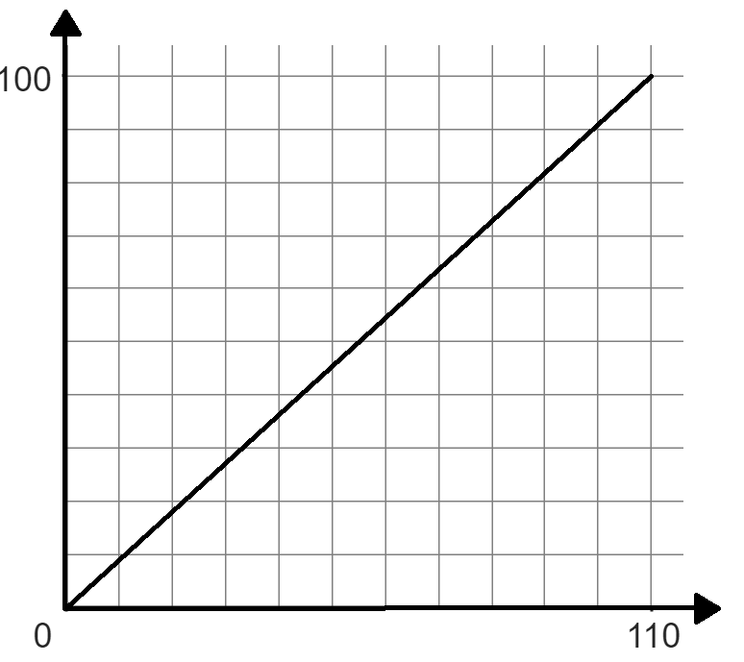
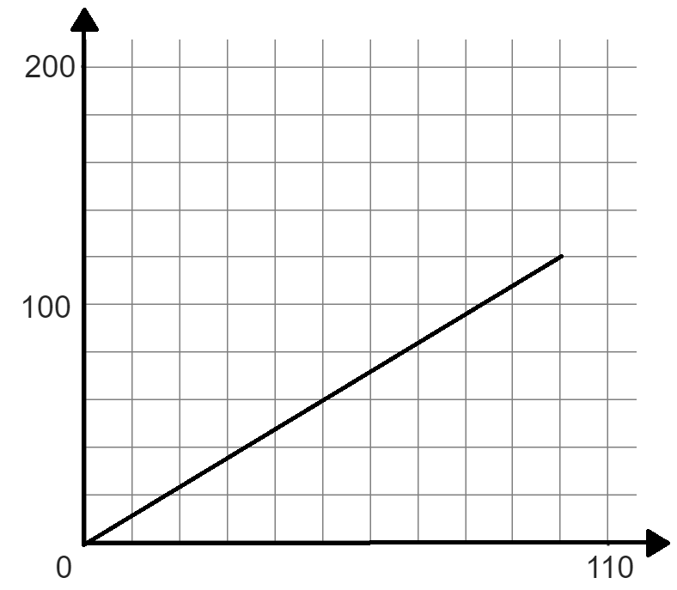
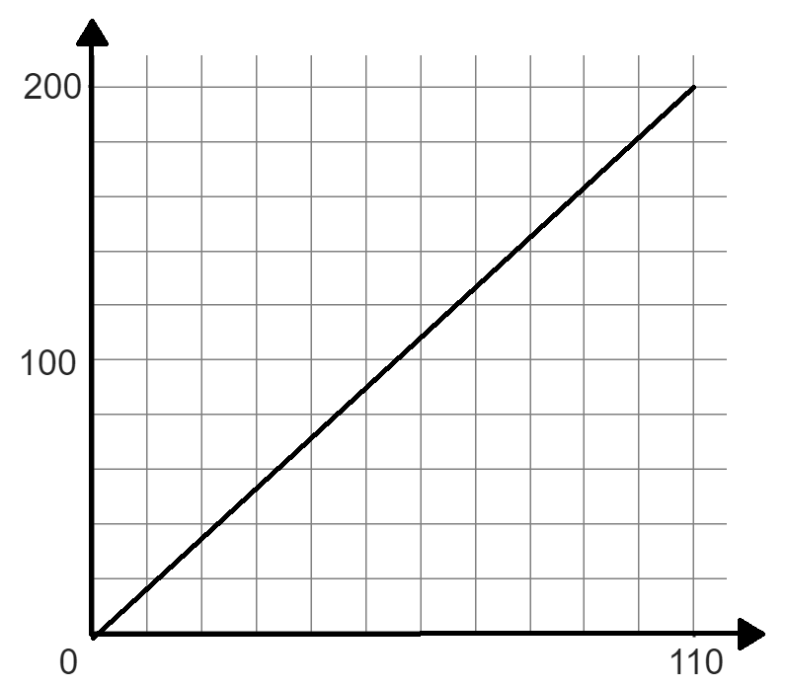
Multiplicative relationships presented graphically
Task B: Other representations of proportional relationships
1) Write what you think are the advantages and disadvantages of using a graph, double number line and ratio table when trying to find a percentage of an amount.
 | Graph | Double number line | Ratio table
Advantages
Disadvantages
Good visual representation
Good visual representation
Concise
Takes time to draw
Answers are dependent on the accuracy of the scale
Takes time to draw as it is scaled
Doesn’t show visual representation
2) Match the ratio table with the correct graph and work out the missing amount using the ratio table.
Amount | %
110 | 100
 | 55
Amount | %
55 | 100
 | 55
Amount | %
100 | 120
 | 36
60.5
30.25
30
%
%
%
A
A
A
Amount | %
110 | 100
Amount | %
55 | 100
Amount | %
100 | 120
55
50%
27.5
50%
10
12%
5.5
5%
2.75
5%
30
36%
60.5
55%
30.25
55%
Mathematics in Education and Industry.
v2.3

